Slide 1
Cost Metrics and Pricing Models
CEN 534 CLOUD COMPUTING
Assoc. Prof. Dr. Nejdet Dogru

Slide 2

Cost Metrics and Pricing Models
Cost metrics and
Pricing models
Reducing Operating Cost
Optimizing IT Environments
Public / On-Premise
Up-Front Investment
Cost of ownership
Metrics, formulas, practices
to perform accurate analysis of cloud adoption plans

Slide 3
Cost Metrics and Pricing Models
Cost metrics and
Pricing models
Business Cost Metrics
Cloud Usage Cost Metrics
Cost Management Considerations

Slide 4
Business Cost Metrics
Cost metrics and
Pricing models
the common types of metrics
used to evaluate
the estimated costs
business value of
leasing cloud-based IT resources when compared to the purchase of on-premise IT resources.

Slide 5
Business Cost Metrics
Cost metrics and
Pricing models
Up-front costs (CAPEX- Capital Expenditure)
are associated with the initial investments that organizations need to make in order to fund the IT resources they intend to use.
Up-front costs for the purchase and deployment of on-premise IT resources tend to be high.
HW, SW, labor,
“Up-front costs for the leasing of cloud-based IT resources tend to be low.
buying
deploying
administering

Slide 6
Business Cost Metrics
Cost metrics and
Pricing models
On-going costs (OPEX-Operational Expenditure)
represent the expenses required by an organization to run and maintain IT resources it uses.
On-going costs for the operation of on-premise IT resources can vary.
licensing fees, electricity, insurance, and labor.
On-going costs for the operation of cloud-based IT resources can also vary, but often exceed the on-going costs of on-premise IT resources (especially over a longer period of time).
virtual hardware leasing fees, bandwidth usage fees, licensing fees, and labor.
Running
Maintaining

Slide 7
Business Cost Metrics (2)
Cost metrics and
Pricing models
Additional costs -
Cost of capital – cost incurred during raising funds.
Sunk costs – prior investment in IT resources (Sunk vs. Up-front)
Integration costs – to ensure compatibility in a new cloud environment (or new IT premise in foreign environment).
Locked-in cost – cost incurred by port (move) IT resources from one cloud to another.

Slide 8
Case Study Example
Cost metrics and
Pricing models
ATN – Advanced Telecom Networks
Sells telecommunication products
2 Applications
Product Catalog Browser
Client Database
Total Cost of Ownership (TOC) Analysis

Slide 9
Case Study Example
Cost metrics and
Pricing models
Product Catalog Browser
4 Virtual Servers on 2 dedicated Physical Servers
300GB Database
Minor Portability issues

Slide 10
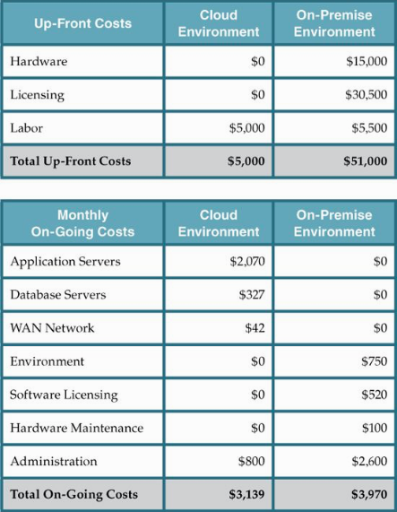
2xServers
4xSW
Deployment
competibility

Slide 11
2xServers
4xSW
Deployment
competibility
1.25$/h x 720 h/m x 2.3 server
$1.09/GB x 300 GB
$0.10/GB x 420 GB/m

Slide 12
Case Study Example
Cost metrics and
Pricing models
Product Catalog Browser
TCO for 3 years
On-Premise: $51K+$3,970x36 = $ 193,920
Cloud:$5000+$3,139x36 =$118,004
CLOUD

Slide 13
Case Study Example
Cost metrics and
Pricing models
Client Database
8 Virtual Servers on 2 dedicated Physical Servers
1,5TB Database
Major Portability issues (Old software)

Slide 14
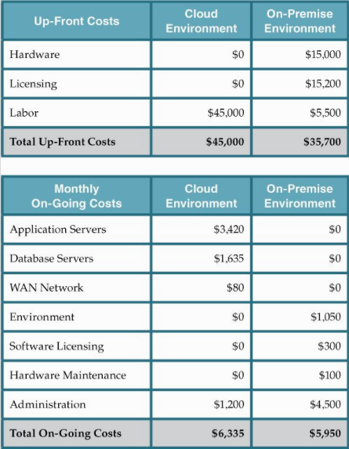
2xServers
8xSW
Old SW

Slide 15
2xServers
8xSW
Old SW
1.25$/h x 720 h/m x 3,8 server
$1.09/GB x 1,5TB
$0.10/GB x 800 GB/m

Slide 16
Case Study Example
Cost metrics and
Pricing models
Client Database
TCO for 3 years
On-Premise: $35,7K+$5,950x36 = $ 251,700
Cloud:$45K+$6,335x36 =$273,060
ON-PREMISE

Slide 17
Cloud Usage Cost Metrics
Cost metrics and
Pricing models
A set of usage cost metrics for calculating costs associated with cloud-based IT resource usage measurements:
Network Usage – inbound and outbound network traffic, as well as intra-cloud network traffic.
Server Usage – virtual server allocation (and resource reservation)
Cloud Storage Device – storage capacity allocation.
Cloud Service – subscription duration, number of nominated users, number of transaction.

Slide 18
Network Usage
Cost metrics and
Pricing models
The amount of data that is transferred over a network connection
network usage is typically calculated using separately measured
inbound network usage traffic
outbound network usage traffic metrics in relation to cloud services or other IT resources.

Slide 19
Network Usage
Cost metrics and
Pricing models
Inbound/Outbound Network Usage Metric
Description – inbound/outbound network traffic
Measurement – Σ, inbound network traffic in bytes
Frequency – continuous and cumulative over a predefined period
Cloud Delivery Model – IaaS, PaaS, SaaS
Example – up to 1 GB free, $0.001/GB up to 10 TB a month

Slide 20
Network Usage (2)-WAN
Cost metrics and
Pricing models
Network usage metrics can be applied to WAN traffic between IT resources of one cloud that are located in different geographical regions
in order to calculate costs for
synchronization,
data replication,
related forms of processing.
Conversely, LAN usage and other network traffic among IT resources that reside at the same data center are typically not tracked.

Slide 21
Network Usage (2)-WAN
Cost metrics and
Pricing models
Intra-Cloud WAN Usage Metric
Description – network traffic between geographically diverse IT resources of the same cloud.
Measurement – Σ, intra-cloud WAN traffic in bytes.
Frequency – continuous and cumulative over a predefined period.
Cloud Delivery Model – IaaS, PaaS, SaaS.
Example – up to 500 MB free daily and $0.01/GB thereafter, $0.005/GB after 1 TB per month.

Slide 22
Server Usage
Cost metrics and
Pricing models
The allocation of virtual servers is measured using common pay-per-use metrics in IaaS and PaaS environments that are quantified by the number of virtual servers and ready-made environments.

Slide 23
Server Usage
Cost metrics and
Pricing models
This form of server usage measurement is divided into
on-demand virtual machine instance allocation
reserved virtual machine instance allocation metrics.

Slide 24
Server Usage
Cost metrics and
Pricing models
The former metric measures pay-per-usage fees on a short-term basis, while the latter metric calculates up-front reservation fees for using virtual servers over extended periods.
The up-front reservation fee is usually used in conjunction with the discounted pay-per-usage fees.

Slide 25
Server Usage (2)
Cost metrics and
Pricing models
On-Demand Virtual Machine Instance Allocation Metric
Description – uptime of a virtual server instance
Measurement – Σ, virtual server start date to stop date
Frequency – continuous and cumulative over a predefined period
Cloud Delivery Model – IaaS, PaaS
Example – $0.10/hour small instance, $0.20/hour medium instance, $0.90/hour large instance

Slide 26
Server Usage (2)
Cost metrics and
Pricing models
Reserved Virtual Machine Instance Allocation Metric
Description – up-front cost for reserving a virtual server instance.
Measurement – Σ, virtual server reservation start date to expiry date
Frequency – daily, monthly, yearly
Cloud Delivery Model – IaaS, PaaS
Example – $55.10/small instance, $99.90/medium instance, $249.90/large instance.

Slide 27
Server Usage (3)
Cost metrics and
Pricing models
Another common cost metric – performance (cpu, RAM).
Cloud providers of IaaS and PaaS environments tend to provision virtual servers with a range of performance attributes.

Slide 28
Cloud Storage Device Usage
Cost metrics and
Pricing models
Cloud storage is generally charged by the amount of space allocated within a predefined period, as measured by the on-demand storage allocation metric.
Similar to IaaS-based cost metrics, on-demand storage allocation fees are usually based on short time increments (such as on an hourly basis).
Another common cost metric for cloud storage is I/O data transferred, which measures the amount of transferred input and output data.

Slide 29
Cloud Storage Device Usage (2)
Cost metrics and
Pricing models
On-Demand Storage Space Allocation Metric
Description – duration and size of on-demand storage space allocation in bytes.
Measurement – Σ, date of storage release / reallocation to date of storage allocation (resets upon change in storage size).
Frequency – continuous
Cloud Delivery Model – IaaS, PaaS, SaaS
Example – $0.01/GB per hour (typically expressed as GB/month)

Slide 30
Cloud Storage Device Usage (2)
Cost metrics and
Pricing models
I/O Data Transferred Metric
Description – amount of transferred I/O data
Measurement – Σ, I/O data in bytes
Frequency – continuous
Cloud Delivery Model – IaaS, PaaS
Example – $0.10/TB

Slide 31
Cloud Service Usage
Cost metrics and
Pricing models
Cloud service usage in SaaS environments is typically measured using the following three metrics:
Application Subscription Duration Metric
Number of Nominated Users Metric
Number of Transactions Users Metric

Slide 32
Cloud Service Usage
Cost metrics and
Pricing models
Application Subscription Duration Metric
Description – duration of cloud service usage subscription
Measurement – Σ, subscription start date to expiry date
Frequency – daily, monthly, yearly
Cloud Delivery Model – SaaS
Example – $69.90 per month

Slide 33
Cloud Service Usage (2)
Cost metrics and
Pricing models
Number of Nominated Users Metric
Description – number of registered users with legitimate access
Measurement – number of users
Frequency – monthly, yearly
Cloud Delivery Model – SaaS
Example – $0.90/additional user per month

Slide 34
Cloud Service Usage (2)
Cost metrics and
Pricing models
Number of Transactions Users Metric
Description – number of transactions served by the cloud service
Measurement – number of transactions (request-response message exchanges)
Frequency – continuous
Cloud Delivery Model – PaaS, SaaS
Example – $0.05 per 1,000 transactions

Slide 35
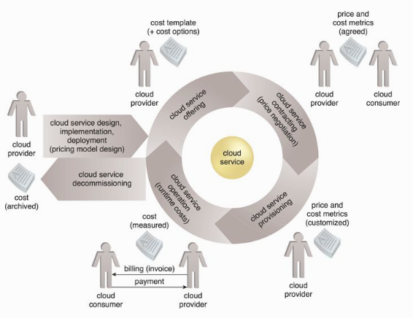
Cost metrics and
Pricing models
Cost
Management
Considerations

Slide 36
Cost Management Considerations
Cost metrics and
Pricing models
Cost management is often centered around the lifecycle phases of cloud services, as follows:
Cloud Service Design and Development – During this stage, the vanilla pricing models and cost templates are typically defined by the organization delivering the cloud service.
Cloud Service Deployment – Prior to and during the deployment of a cloud service, the backend architecture for usage measurement and billing-related data collection is determined and implemented, including the positioning of pay-per-use monitor and billing management system mechanisms.
Cloud Service Contracting – This phase consists of negotiations between the cloud consumer and cloud provider with the goal of reaching a mutual agreement on rates based on usage cost metrics.

Slide 37
Cost Management Considerations (2)
Cost metrics and
Pricing models
Cloud Service Offering – This stage entails the concrete offering of a cloud service’s pricing models through cost templates, and any available customization options.
Cloud Service Provisioning – Cloud service usage and instance creation thresholds may be imposed by the cloud provider or set by the cloud consumer. Either way, these and other provisioning options can impact usage costs and other fees.
Cloud Service Operation – This is the phase during which active usage of the cloud service produces usage cost metric data.
Cloud Service Decommissioning – When a cloud service is temporarily or permanently deactivated, statistical cost data may be archived.

Slide 38
Cost metrics and
Pricing models
Cost Management Considerations

Slide 39
Pricing Models
Cost metrics and
Pricing models
The pricing models used by cloud providers are defined using templates that specify unit costs for fine-grained resource usage according to usage cost metrics.
Various factors can influence a pricing model, such as:
market competition and regulatory requirements.
overhead incurred during the design, development, deployment, and operation of cloud services and other IT resources.
opportunities to reduce expenses via IT resource sharing and data center optimization.

Slide 40
Pricing Models (2)
Cost metrics and
Pricing models
A pricing model can contain multiple price templates,
whose formulation is determined by variables like:
Cost Metrics and Associated Prices –
These are costs that are dependent on the type of IT resource allocation (such as on-demand versus reserved allocation).
Fixed and Variable Rates Definitions –
Fixed rates are based on resource allocation and define the usage quotas included in the fixed price, while variable rates are aligned with actual resource usage.

Slide 41
Pricing Models (2)
Cost metrics and
Pricing models
A pricing model can contain multiple price templates, whose formulation is determined by variables like:
Volume Discounts –
More IT resources are consumed as the degree of IT resource scaling progressively increases, thereby possibly qualifying a cloud consumer for higher discounts.
Cost and Price Customization Options –
This variable is associated with payment options and schedules. For example, cloud consumers may be able to choose
monthly,
semi-annual, or
annual payment installments.

Slide 42
Additional Considerations
Cost metrics and
Pricing models
Negotiation –
Cloud provider pricing is often open to negotiation, especially for customers willing to commit to higher volumes or longer terms.
Payment Options –
pre-payment
post-payment.
Cost Archiving –
By tracking historical billing information both cloud providers and cloud consumers can generate insightful reports that help identify usage and financial trends.

